Slide 1
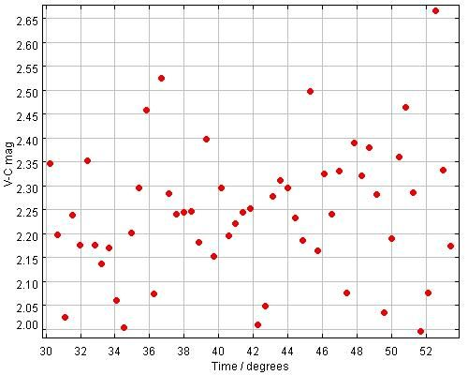
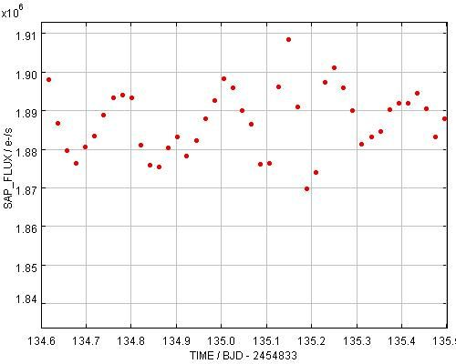
A Comparison of the Characteristics of the Central Stars of M57 and NGC 6826 Poster – P1021
First Kepler Science Conference
M 57
Wright 28
M57 and NGC 6826 In the fall of 2009 a short imaging run of 56 images was taken of the Planetary Nebula M57 with the 11” AAVSONET telescope at Astrokolholz observatory in Cloudcroft, NM. Each image was a 90 second exposure using an I filter. The period of the star is ~0.19 of a day, with a magnitude change of 0.6 magnitude. There are hints in the light curve of a possible close contact binary of a very short period, with lots of brightening and dimming that confuse the interpretation. Now with recent Kepler data (4 runs at this time) there is enough information on NGC 6826 to compare it with the ground based M57 data. NGC 6826 has a period of .619 of a day and a magnitude change of 10 mmag. It also has the characteristic light curve of a binary star. Both stars also show light spikes and dips of an unknown cause.
Kepler
NGC 6826

